Slide 1
Lab 1 review
Zhicheng Dong zdo@kth.se
Qiaolan Luo qiaolan@kth.se
2024-01-31

Slide 2
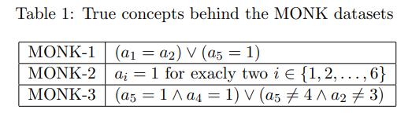
Assignment 0
MONK-1 and MONK-3: AND, OR
MONK-2: requires counting occurrences across multiple attributes

Slide 3
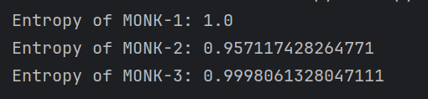
Assignment 1

Slide 4

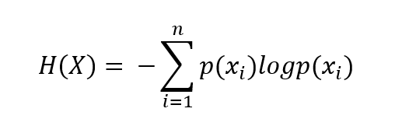
Assignment 2
1. Uniform distribution: the probability of each event is equal
2. Non-uniform distribution: the probability of each event is not equal

Slide 5
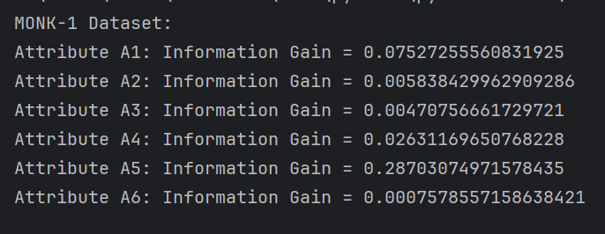
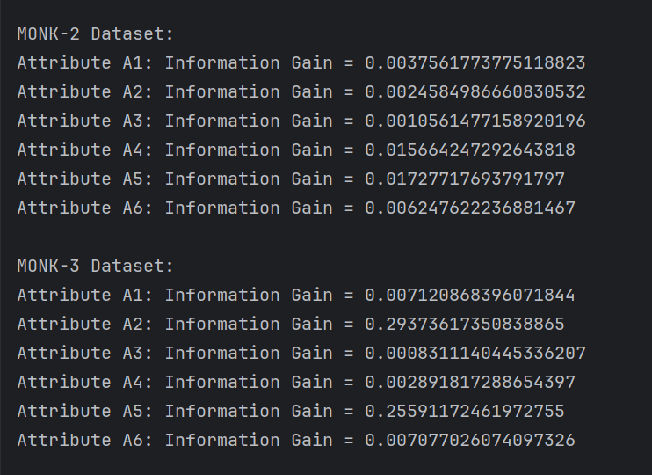
Assignment 3
MONK-1: A5
MONK-2: A5
MONK-3: A2

Slide 6
Assignment 4
information gain maximized, the entropy of the subsets is usually lower
Using information gain for splitting : reduce uncertainty

Slide 7
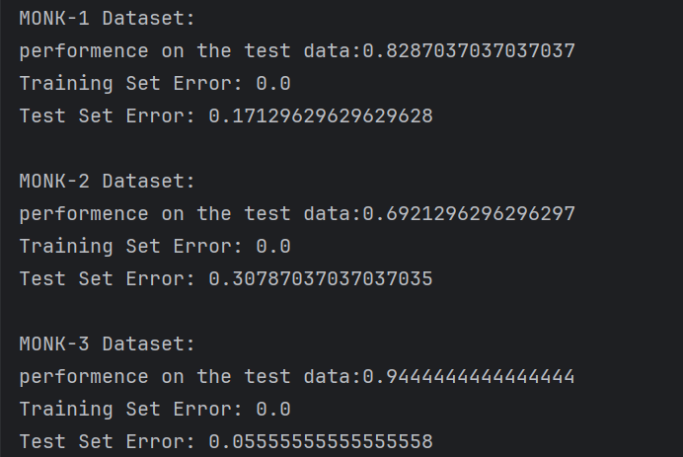
Assignment 5

Slide 8
Assignment 6
Without pruning: low bias, high variance
Pruning: low variance

Slide 9
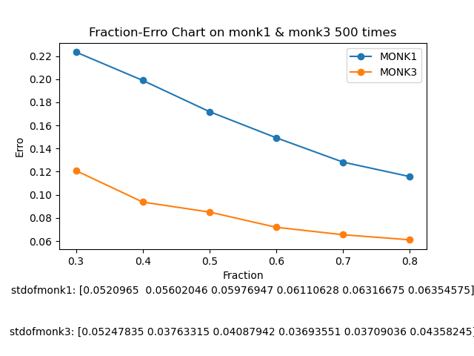
Assignment 7

